Slide 1
Aneka
Cloud
Architecture
Domain: Cloud Computing
Presented by:
Divya Hari Kumar
https://github.com/divziv
https://www.linkedin.com/in/divyaharikumar/

Slide 2
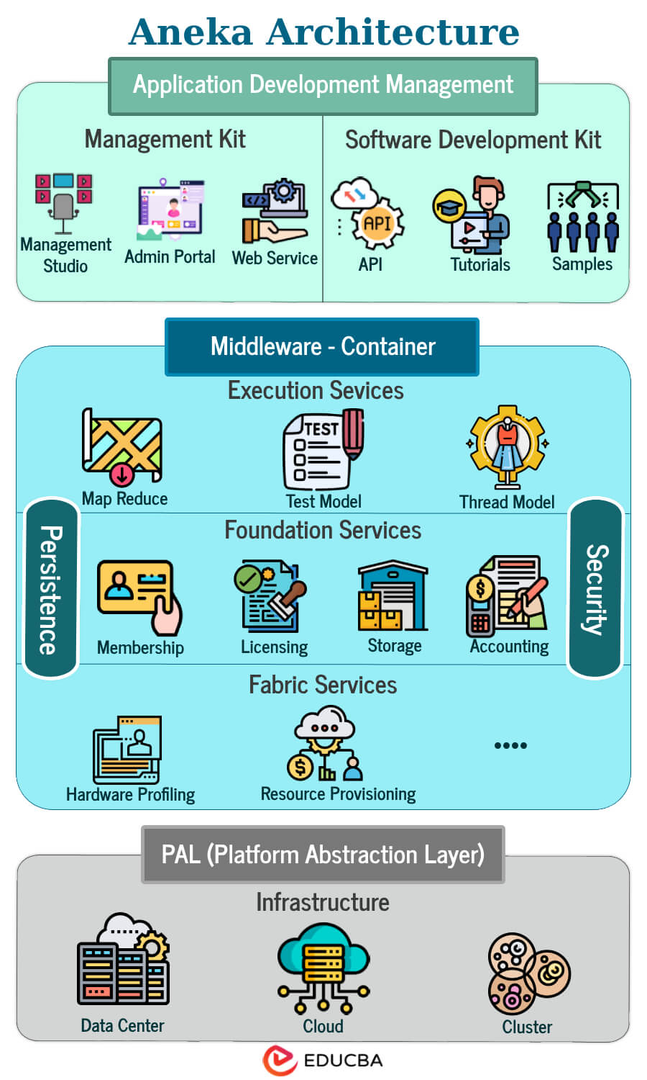
Introduction
Aneka is a robust platform and framework designed to simplify the development and execution of distributed applications within diverse cloud environments.
It acts as middleware, abstracting the complexities of underlying cloud infrastructure, allowing developers to focus on application logic.
Key benefits include enhanced scalability, efficient resource management, and flexible programming models, enabling applications to adapt to dynamic workloads.

Slide 3
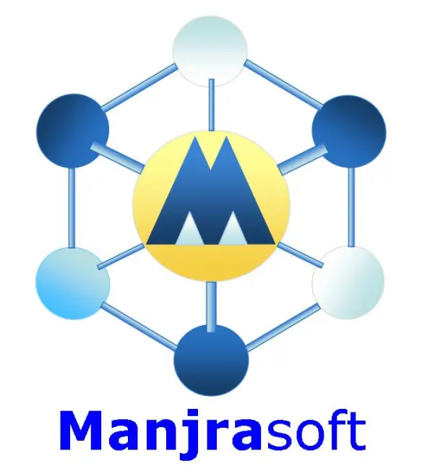
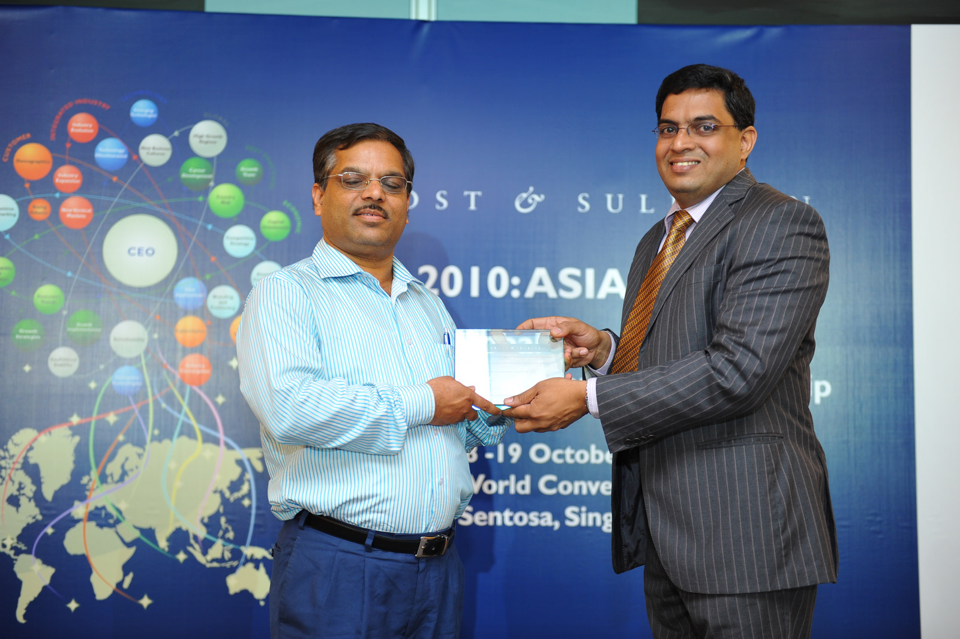
Manjrasoft
🌐 About Manjrasoft
Founded: 2008
Headquarters: Melbourne, Australia
Founder: Dr. Rajkumar Buyya
Core Focus: Cloud computing software and solutions
Flagship Product: Aneka – A .NET-based Platform-as-a-Service (PaaS)
🌍 Global Reach
Partnered with universities, research labs, and companies across the globe.

Slide 4
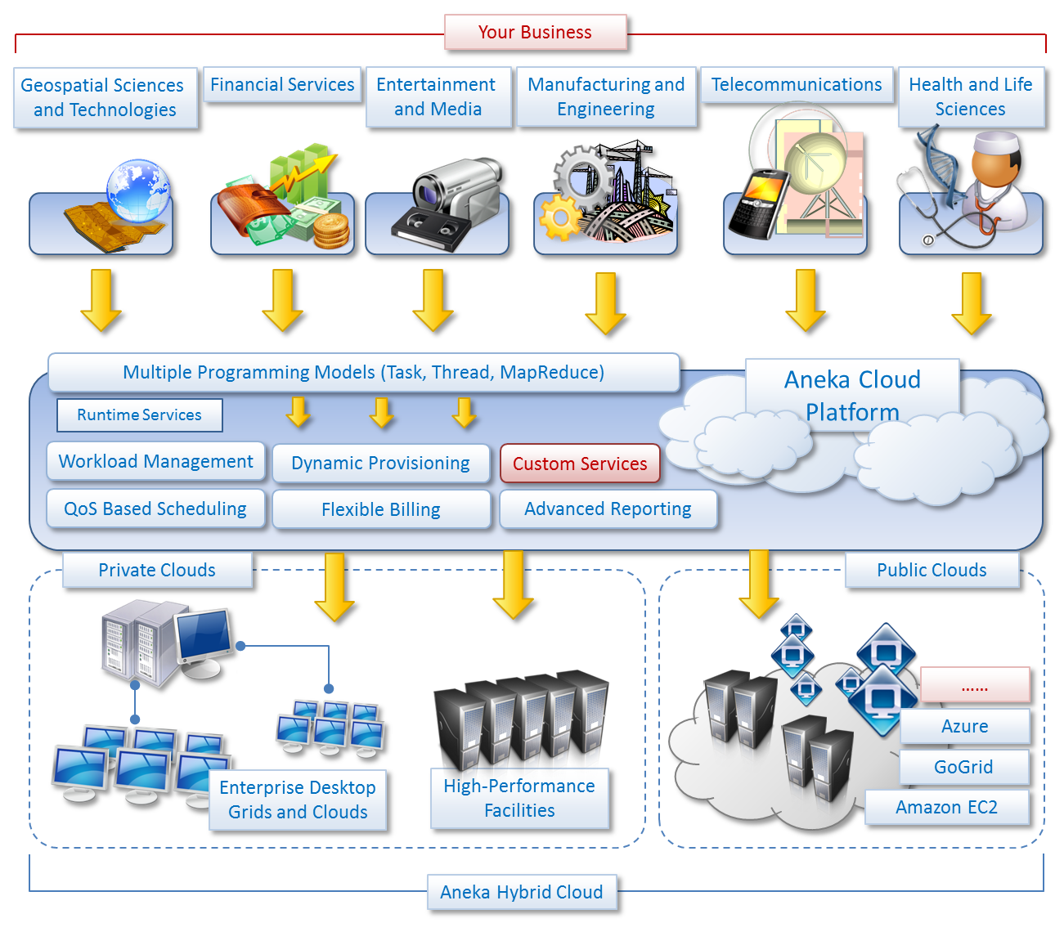
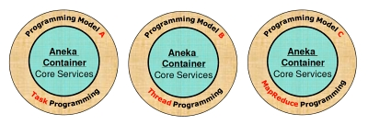
Products Provided
💡 Mission
To empower organizations, researchers, and developers with innovative cloud technologies for scalable and efficient application development.
🛠️ Key Offerings
Aneka Cloud Application Platform
Cloud consulting and integration services
Custom cloud solutions for enterprises, research, and education

Slide 5
Core Concepts
Distributed Application Development
Cloud Middleware
Resource Aggregation
Programming Models
Run across multiple machines
Handle large workloads or complex tasks
Layer of software
Communication
Resource Management
Desktops
Servers
Data centers
Task Computing
Thread Computing
MapReduce

Slide 6
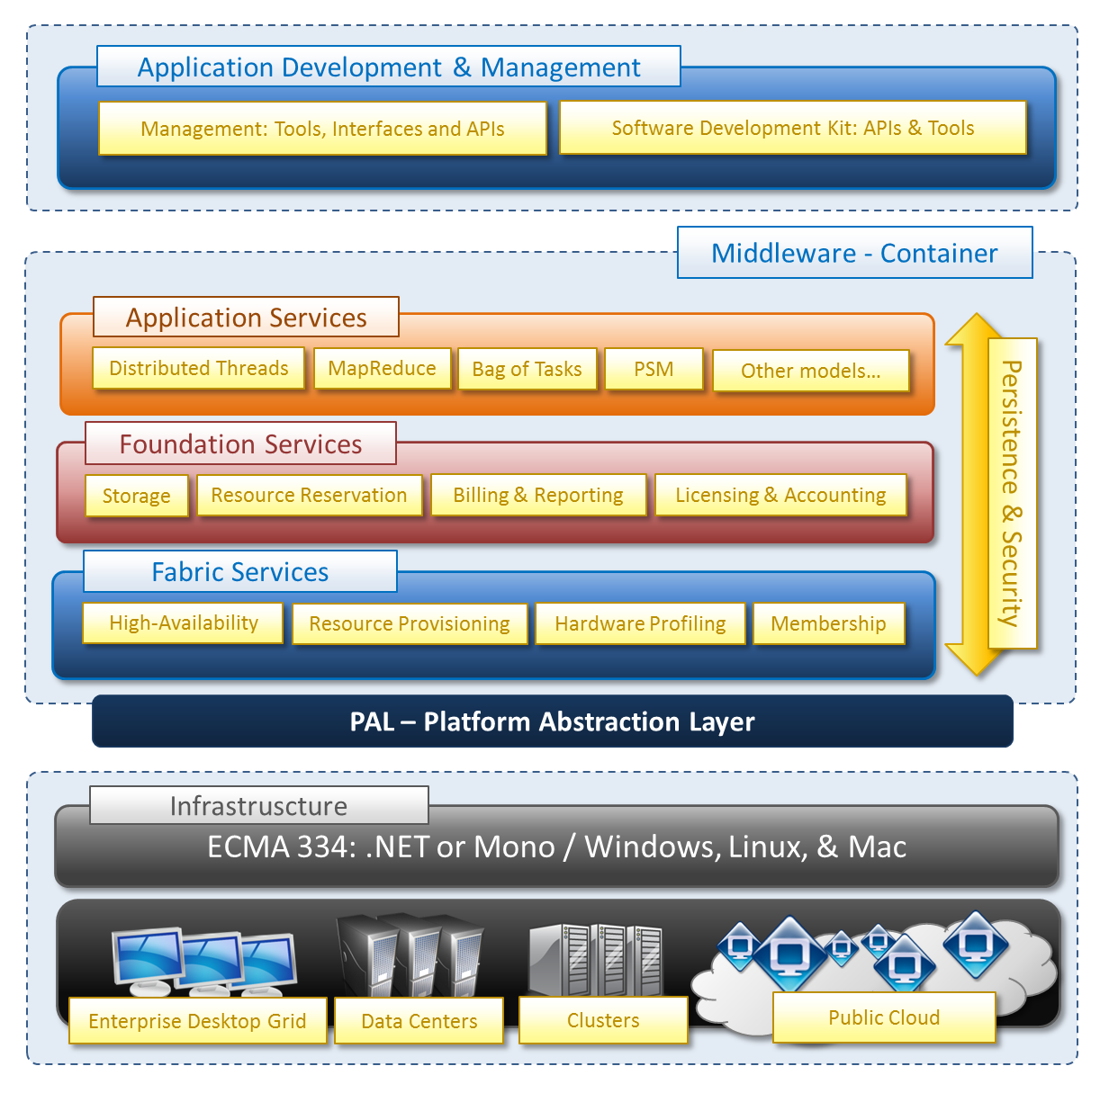
Architecture

Slide 7
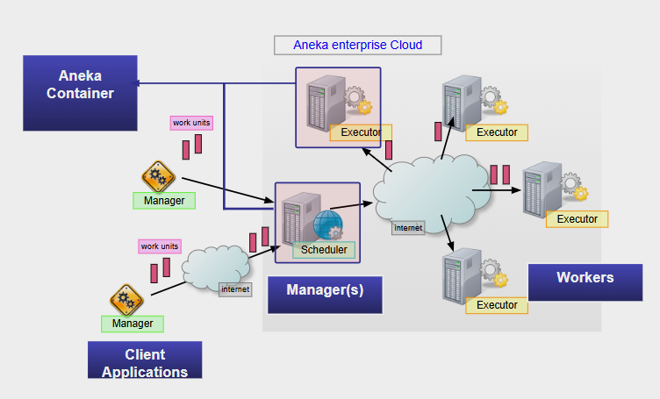
Architecture

Slide 8
Architecture
Aneka Container:
Role: Acts as the central hub or container for the Aneka environment. It encapsulates the core services and manages the overall application lifecycle.
Manager:
Role: The Manager is a key component responsible for:
Resource Management: Discovering, allocating, and managing the available compute resources (Workers).
Job Scheduling: Distributing tasks (Work Units) to the Workers based on resource availability and scheduling policies.
Monitoring: Tracking the progress of tasks and the health of the system.
Client Applications:
Role: These are the applications that interact with the Aneka platform. They submit tasks to the Manager and receive the results.

Slide 9
Architecture
Workers:
Role: These are the compute resources (nodes) that execute the actual tasks (Work Units) of the distributed application. They receive tasks from the Manager, process them, and return the results.
Work Unit:
Role: The smallest unit of work that can be executed by Aneka. It defines the granularity of the application's tasks.
Executors:
Role: These are the components within the Workers that actually execute the Work Units. They handle the runtime environment and the specific logic of the tasks.
Scheduler:
Role: The component within the Manager that organizes and dispatches Work Units to the Workers.

Slide 10
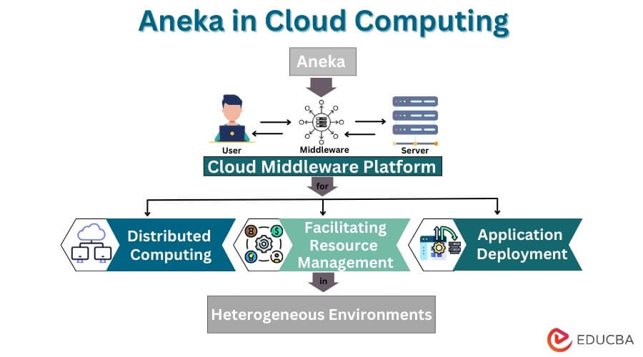
Overall Architecture
The Aneka Architecture is designed to create a platform for distributed applications by abstracting the complexities of resource management and task execution. The Manager acts as the central control point, managing resources and scheduling tasks, while the Workers execute the actual Work Units. Client Applications interact with the platform to submit tasks and receive results.

Slide 11
Architectural Layers
Application Services Hardware profiling
Resource provisioning
Foundation Services Task coordination
Data management
Application Services Scheduling
Programming models

Slide 12
Fabric Services
Low-level management of cloud resources
Dynamic resource provisioning
Automatically allocates and releases resources.
Efficient allocation and utilization.
Hardware profiling
Resource discovery
Identifying and analyzing the hardware resources allocated to virtual machines or services.
Locates available resources within the cloud environment.

Slide 13
Foundation Services
Core middleware functionalities
Data management
Enable distributed application execution.
Handles data storage, retrieval, and transfer.
Task coordination
Security services
Manages the distribution and execution of application tasks.
Provides authentication and authorization mechanisms.

Slide 14
Application Services
1
Focus on the execution of distributed applications.
1
2
2
Scheduling: Manages the scheduling of application tasks.
3
Programming models: Supports Task Computing, Thread Computing, and MapReduce.
3
4
4
Quality of Service (QoS) management: Ensures performance.

Slide 15
Aneka Container
Runtime environment where distributed applications are executed.
Manages individual nodes and facilitates communication.
Handles resource monitoring and fault tolerance.
Provides a standardized execution environment.

Slide 16
Management and Integration
Management Console
Integration Adapters
Provides administrators with a centralized interface for monitoring and controlling the Aneka framework and running applications.
It allows for resource management, application deployment, and performance monitoring.
Enables Aneka to connect with various cloud infrastructures and middleware components, ensuring compatibility and interoperability.
Adapters for popular cloud platforms and storage systems.

Slide 17
Key Features and Benefits
Scalability
Efficient Resource Management
Programming Flexibility
Cloud Integration
Fault Tolerance

Slide 18
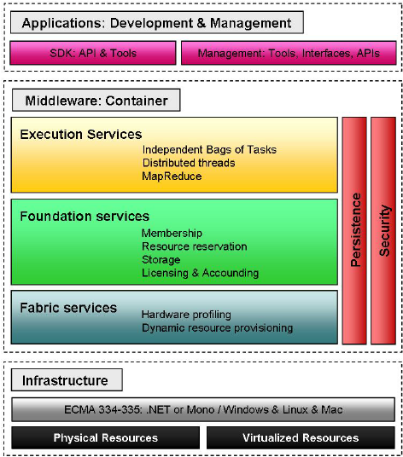
Features

Slide 19
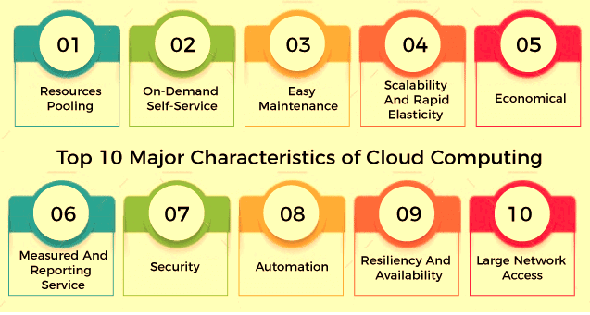
Features and Benefits

Slide 20
Use Cases
Scientific Computing
Data Analytics
Media Processing
Financial Modeling

Slide 21
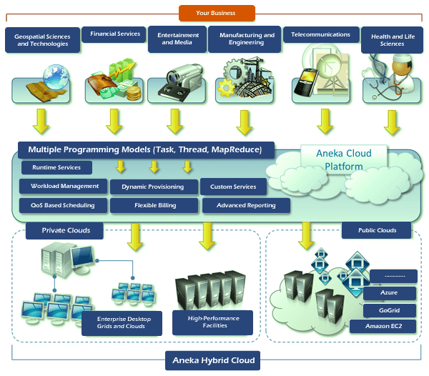
Use Cases

Slide 22
Conclusion
In essence, Aneka empowers developers to effortlessly build and deploy scalable, efficient cloud applications by simplifying the complexities of distributed computing. Its adaptable architecture and support for diverse programming models make it a versatile tool across various industries. Looking forward, Aneka is poised to evolve with advancements in AI integration, containerization, and edge computing, ensuring it remains a leading platform in the dynamic landscape of cloud innovation.
Cloud

Slide 23
THANK YOU!

